Slide 1
Module 1:
The position of self-financing tertiary
education programmes in Hong Kong
June 2014
Federation for Self-financing Tertiary Education

Slide 2
Some interesting questions
Where and when you learn how to use Whatsapp?
Where and when you learn how to buy stocks?
Where and when you learn how to set a test paper?

Slide 3
Formal education
The highly institutionalized, chronologically graded and hierarchically structured ‘education system’, spanning lower primary school and the upper reaches of the university

Slide 4
Non-formal education
Any organized, systematic, educational activity carried on outside the framework of the formal system to provide selected types of learning to particular subgroups in the population, adults as well as children such as:
Elementary book-keeping
Flower arrangement
Chinese calligraphy

Slide 5
Informal education
lifelong process by which every person acquires and accumulates knowledge, skills, attitudes and insights from daily experiences and exposure to the environment - at home, at work, at play. Generally, informal education is unsystematic; yet it accounts for the great bulk of any person’s total lifetime learning - including that of even a highly ‘schooled’ person.

Slide 6
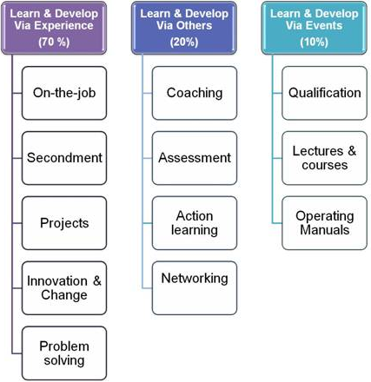
70:20:10 Learning Model

Slide 7
Formal Education System in HK
 | 1970s | 1980s | 1990s | 2000s | 2010s
Primary (1st tier) | 6 years | 6 years | 6 years | 6 years | 6 years
Secondary (2nd tier) | 5+2 3+3 | 5+2 3+3 Vocational courses | 5+2 Vocational courses | 5+2 PYJ | 3+3 YJD
Tertiary (3rd tier) | OD HD Degree (3 and 4 years) | OD HD Degree (3 and 4 years) | OD HD Degree (3 years) | AD OD HD Degree (3 years) | OD HD Degree (4 years)

Slide 8
Social Demand Approach
Provide enough capacity for all those qualified and willing to enroll in institutions of education and training.
In UK, the 1963 Robbins Report, adhered to the principle of social demand as a basis for growth and expansion of higher education.

Slide 9
Manpower Requirements Approach
developing occupation-education matrices linking qualification levels required for different categories of jobs.
linking education with economic planning

Slide 10
Rates-of-return Analysis
Returns to investment in education
which can be further divided into:
Individual return
Social return

Slide 11
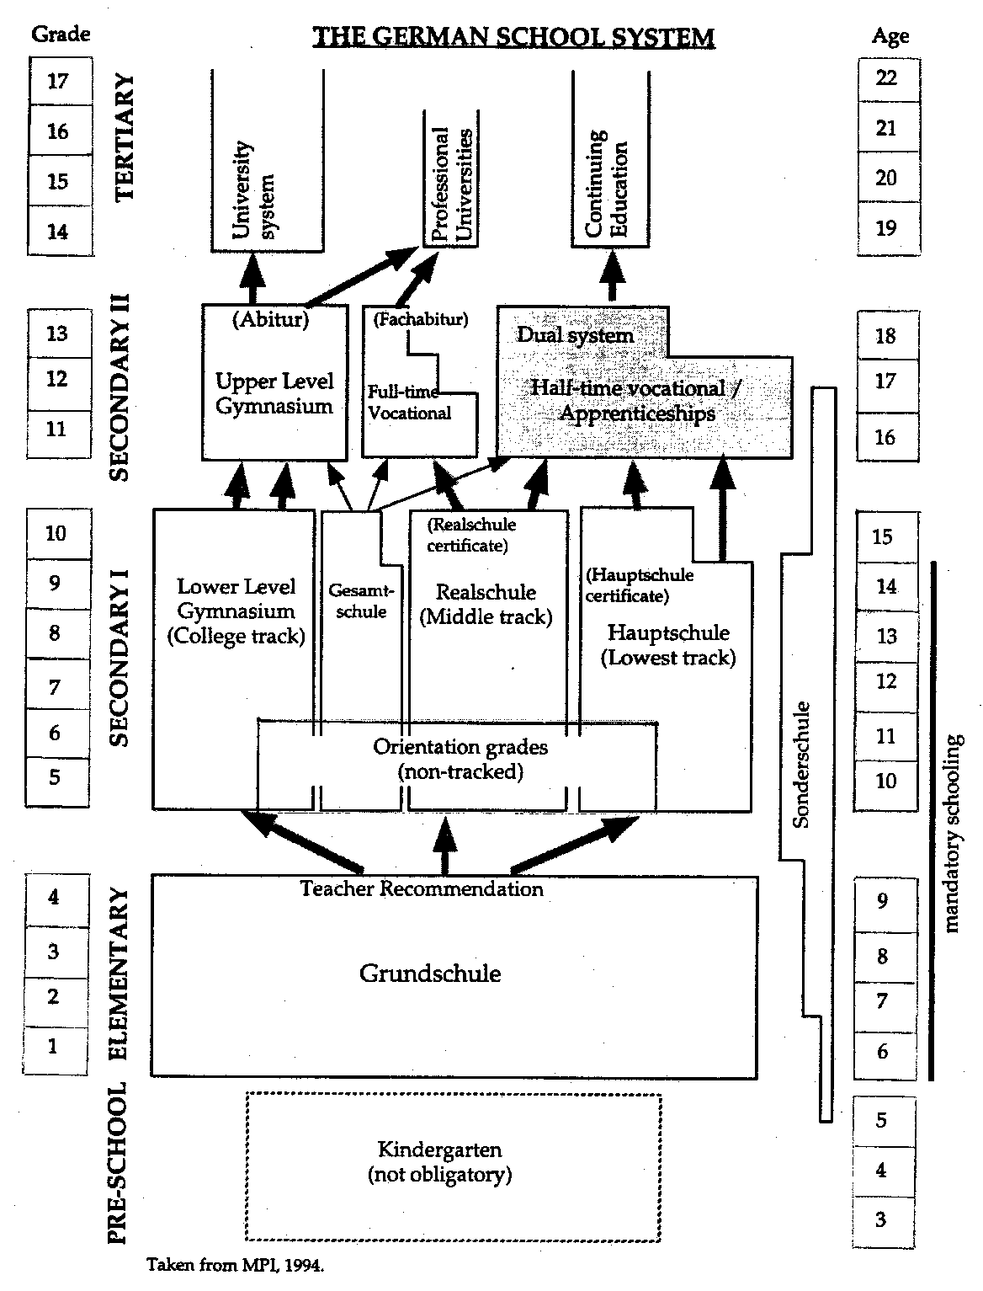

Slide 12
Funding of Education
Who is the stakeholders of education?
Who should pay?
What Egalitarianism means in education?

Slide 13
Government Expenditure on Education
 |  |  |  | Financial year (April - March)
 |  |  |  |  | 2008-09 | 2012-13 | 2013-14 Revised Estimates
Total expenditure on education (HK$ million) |  |  |  |  | 74,995 | 76,600 | 76,856
As percentage of total government expenditure (%) |  |  |  |  | 24.0 | 20.3 | 17.6
As percentage of Gross Domestic Product (GDP) (%) |  |  |  |  | 4.4 | 3.8@ | 3.6@
Recurrent expenditure on education under General Revenue Account (HK$ million) |  |  |  |  | 49,863 | 60,449 | 63,752
Spent on (%) |  | Primary education |  |  | 21.7 | 21.2 | 21.2
 |  | Secondary education |  |  | 37.8 | 37.4 | 36.1
 |  | Post-secondary education⁽¹⁾⁽²⁾ |  |  | 25.8 | 26.2 | 27.5
 |  | Others⁽¹⁾⁽²⁾⁽³⁾ |  |  | 14.7 | 15.2 | 15.2

Slide 14
Education expenditure data HK
 | Rank | Value | Date
Education expenditure, public (% of GDP) | 131 | 3,5 | 2012
Education expenditure (% of GNI) | 145 | 2,8 | 2012
Education expenditure, public (% of government expenditure) | 48 | 18,6 | 2012
Education expenditure, public (% of education expenditure) | 158 | 81,8 | 2012
Education expenditure, public, not allocated by level (% of education expenditure) | 53 | 6,6 | 2012
Education expenditure per student (% of per capita GDP) | 81 | 19,6 | 2012

Slide 15
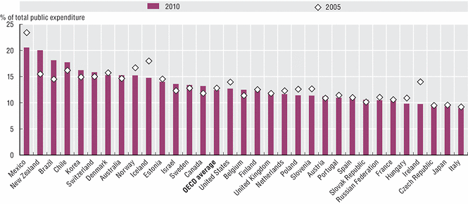
Public spending on education as % of total public spending

Slide 16
Public spending on education as % of GDP

Slide 17
Focus of the next session
What is the position of the self-financing tertiary education sector in Hong Kong?
What are the challenges of the Sector?

Slide 18
Some possible challenges
Equity in Education | Evaluation and Assessment Frameworks for Improving learning Outcomes | Migrant Education
Pathways for Disabled Students to Tertiary Education and Employment | Recognising non-formal and informal learning | School Leadership
Teacher Policy | Tertiary Review | Vocational Education and Training (VET) Learning for Jobs

